Slide 1

Introduction To Javascript
M3-01
Participate! The more engagement the better! You are NEVER interrupting me!

Slide 2

Welcome to JavaScript?
CSS
HTML

Slide 3
Overview of JavaScript
Differences between Java and JavaScript
Including Javascript on your web pages
Declaring and Using Variables
Strict and Loose Equality
Strings, Arrays, Loops and Simple Objects

Slide 4
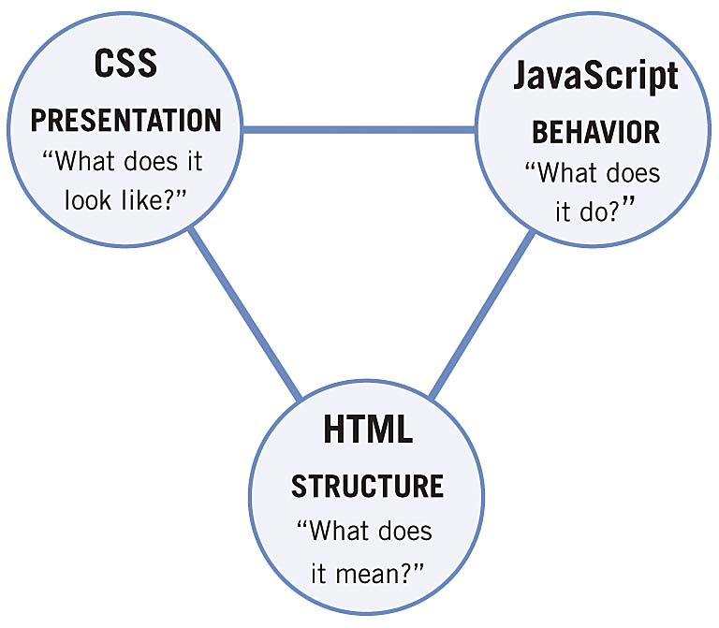
Client Side Scripting - Separation of Concerns
HTML - provides content
CSS - provides presentation
JavaScript - provides behavior

Slide 5
Benefits of Client Side Scripting
Client Side Form Validation
Gives us the ability to interact and manipulate page content programmatically. (DOM)
Useful for responding to event behaviors (clicks, keypress, scroll, resizing, hover, etc)

Slide 6
Benefits of Client Side Scripting
Code executes in the user’s browser thus saving server side resources. (Better user experience)
Calling web services and loading data without reloading the page
Animations

Slide 7
Important!
Overview of Javascript
Created at Netscape in 1995 for Netscape Navigator web browser
Based loosely off of C (like Java and C#)
Java requires a run-time (JVM) whereas Javascript runs in the browser.
Java is compiled whereas Javascript is an interpreted line by line as it runs.

Slide 8

Toolset for Vanilla JavaScript
VS Code - Integrated Development Environment (IDE)
LiveServer
ESLint (static code analysis tool for identifying potential problems)
JavaScript Intellisense
Chrome
Javascript runtime
Debugging
Node.js
https://developer.mozilla.org/en-US/docs/Web/JavaScript https://www.w3schools.com/js/default.asp

Slide 9

Playtime: Let’s Take A Browser Tour
We can run JavaScript by importing it into our HTML. (For applications we build)
We can run JavaScript in the browser’s console (playtime and testing only - nothing saves)
Use Shift-Enter to write more than one line of code in the browser

Slide 10
Opening a Project with VS Code
Open the Project Directory in VS Code
4 Ways
Open Folder from Project View (when nothing is open)
From the project folder in terminal: code .
File > Open Folder (when no other projects are open)
File > Add Folder to Workspace (when other projects are open)
Right click on the html file (index.html) and select “Open with Live Server”

Slide 11
JavaScript Basics

Slide 12
Comments
/*
Example of a multi-line comment just like in C#/Java
*/
// Single line comment

Slide 13
Static vs Dynamic Typing
Important!
Statically Typed Language (Java)
Language enforces the data types once declared
int x
x is always an int
x = 10;
x = “hello”; ← Error
Dynamically Typed Language (JavaScript)
Language infers the data type from the value it currently holds.
let x
x = 10;
x = “hello”; ← OK

Slide 14
Data Types
The typeof operator can be used to identify the data type.
Data Type conversion is often handled implicitly by JavaScript, but can be done explicitly using functions.
String(123) ← converts 123 into a string
Number(“123”) ←- converts “123” into a number
parseFloat(“3.14”) ← converts a string to a floating point number
parseInt(“10”) ← converts a string to an integer
JavaScript has the following data types:
string
number
boolean
object
function
undefined (primitives) - declared but value is not assigned null - absence of value (objects)
NaN - Not a number
JavaScript Data Types and Conversion Methods on W3Schools

Slide 15
const and let have block scope (var does not)
Variables
Use const and let instead of var (var is bad - do not use unless you absolutely have to)
You use let when you know the value of the variable needs to be changeable. let name; name = ‘steve’;
The reserved word, const, (short for "constant") is the alternative to let. You use const when the value to the variable must not be changed after it's been assigned. const num = 17;
Unlike let, where assignment is not required when the variable is declared, const insists on it. JavaScript raises an error if you attempt to declare a const and do not assign a value at the same time.
Notes:
No error is thrown if you declare the same variable twice using var (conversely, both let and const will throw an error if a variable is declared twice)
Variables declared with var are not block scoped (although they are function scoped), while with let and const they are. This is important because what’s the point of block scoping if you’re not going to use it.

Slide 16
A Quick Note About Const
const is the preferred way to declare all variables.
const makes variables immutable, so you know that no matter where you see the variable in code, the value can't have changed after it was originally assigned.
Using const helps to keep your code more readable and easier to understand since the value can't be modified after assignment.
Use let only in the circumstances when you know the variable's value must be changeable—for instance, when the variable serves as a count of something, or a total sum. Otherwise, default to using const

Slide 17
Naming Standards
Javascript follows camel case naming standards similar to Java and can’t be keywords
Google JavaScript Style Guide
https://google.github.io/styleguide/jsguide.html

Slide 18
JavaScript is a Truthy Language
Everything in the language evaluates to either true or false
falsy (evaluate to false): false, 0, ‘’, null, undefined, NaN
truthy (evaluate to true): everything else

Slide 19
Operators
Logical operators ( !, &&, ||, ^ )
Comparison operators (==, !=, >, <, <=, >=, ===, !==)
Mathematical operators ( +, -, *, /, % )
Shorthand operators ( +=, -=, *=, /=, %=)
Increment / Decrement ( ++, -- )

Slide 20
Loose Equality ( ==, != )
Loose Equality compares two operands for value only AFTER converting to a common type
const x = 5;
const y = "5";
const result = (x == y); ← This evaluates to true.

Slide 21
Strict Equality ( === , !==)
Strict Equality compares two operands for type and value equality const x = 5;
const y = 5;
const result = (x === y); ← This evaluates to true.
const x = 5;
const y = ‘5’;
const result = (x === y); ← This evaluates to false.

Slide 22
Functions
defined with the word function
lack a return a return type
have no access modifier
parameters do not have defined data types

Slide 23
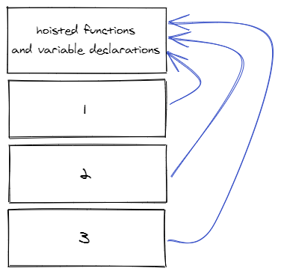
JavaScript Load Order and Hoisting
Hoisting on W3Schools
Scotch.io Hoisting Tutorial
HTML and JavaScript load sequentially
Order of JavaScript and JS files is important
Functions and variable declarations are “hoisted” to the top.
1, 2, 3 - JS files imported into an HTML file.
The files are not hoisted, but function and variable declarations are hoisted.

Slide 24
Math and String Functions
isNaN() - returns true or false if a variable is not a number
Math
Built in Math object that has properties and methods for mathematical operations
Math.PI, Math.abs(), Math.floor(), Math.random()
Documentation on MDN
String
The String data type has properties and methods to manipulate the value of the String
.length()
.endsWith(), .startsWith()
.indexOf()
.split()
toLowerCase(), .toUpperCase()
.substr(startIndex, numberOfCharactersToReturn)
.substring(startIndex, endingIndex)
.trim()
Documentation on MDN

Slide 25
Arrays
Here's the syntax for declaring and initializing a new empty array:
let testScores = [];
This line declares a new variable called testScores and assigns it an empty array.
If you know the values of your array, you can provide those values at the time of initialization:
let testScores = [ 85, 96, 80, 98, 89, 70, 93, 84, 66, 96 ]; testScores[2] = 79; // update the value at index 2 to79
let size = testScores.length;

Slide 26
Useful Arrays Functions
pop()
The pop() function is related to the push() function. pop() removes an element from the end of the array. It also returns that element that was removed:
let numbers = [1, 2, 3, 4];
let removedElement = numbers.pop();
// numbers now is [1, 2, 3];
// removedElement is 4;

Slide 27
Useful Arrays Functions
push()
The push() function adds a new element to the end of an array:
let numbers = [1, 2, 3];
numbers.push(4);
// numbers is now [1, 2, 3, 4]

Slide 28
Useful Arrays Functions
shift()
The shift() function is related to the unshift() function. shift() removes an element from the beginning of the array. It also returns the element that was removed:
let numbers = [1, 2, 3, 4];
let removedElement = numbers.shift();
// numbers now is [2, 3, 4];
// removedElement is 1;

Slide 29
Useful Arrays Functions
unshift()
The unshift() function adds a new element to the beginning of an array:
let numbers = [2, 3, 4];
numbers.unshift(1);
// numbers is now [1, 2, 3, 4];

Slide 30
Useful Arrays Functions
includes()
The includes() function checks if a given value is in an array. It won't tell you how many times it's in the array, but the function returns true if it found the value at all or false if it isn't found:
let numbers = [1, 2, 3];
let foundThree = numbers.includes(3); // foundThree will be true
let foundFour = numbers.includes(4); // foundFour will be false

Slide 31
Useful Arrays Functions
indexOf()
The indexOf() function finds the location of a value in an array. It finds the first instance of the value and then returns the index to that element. If it can't find the value, it returns -1:
let numbers = ['one', 'two', 'three', 'four', 'three', 'five', 'three'];
let indexOfThree = numbers.indexOf('three'); // indexOfThree will be 2, the index of the first 'three'
let indexOfFour = numbers.indexOf('six'); // indexOfFour will be -1

Slide 32
Useful Arrays Functions
lastIndexOf()
The lastIndexOf() function finds the last location of a value in an array. It finds the last instance of a value and then returns the index to that element. If it can't find the value, it returns -1:
let numbers = ['one', 'two', 'three', 'four', 'three', 'five', 'three'];
let indexOfThree = numbers.lastIndexOf('three'); // indexOfThree will be 6, the index of the last 'three'
let indexOfFour = numbers.lastIndexOf('six'); // indexOfFour will be -1

Slide 33
Useful Arrays Functions
join()
The join() function takes an array and returns a string, putting a value in between every element. The array itself is not changed:
let numbers = [1, 2, 3];
let joinedNumbers = numbers.join(';');
// joinedNumbers is "1;2;3"

Slide 34
Useful Arrays Functions
reverse()
The reverse() function reverses an array. The first element becomes the last element, and the last element becomes the first:
let numbers = [1, 2, 3];
numbers.reverse();
// numbers is [3, 2, 1];

Slide 35
For Loop
let testScores = [ 85, 96, 80, 98, 89, 70, 93, 84, 66, 96 ];
for(let i = 0; i < testScores.length; i++) {
console.log(testScores[i]);
}

Slide 36
How To Include Javascript In Web Pages
1. <script> tag in the <body>
<html lang="en-US">
<head>
<meta charset="UTF-8">
<meta name="viewport" content="width=device-width, initial-scale=1">
<title>Today's Date</title>
</head>
<body>
<script>
let d = new Date();
alert("Today's date is " + d);
</script>
</body>
</html>
Avoid if possible

Slide 37
How To Include Javascript In Web Pages
2. <script> tag in the <head>
<html lang="en-US">
<head>
<meta charset="UTF-8">
<meta name="viewport" content="width=device-width, initial-scale=1">
<title>Today's Date</title>
<script>
let d = new Date();
alert("Today's date is " + d);
</script>
</head>
<body>
</body>
</html>
Avoid if possible

Slide 38
How To Include Javascript In Web Pages
3. <script> tag with the script reference
<!DOCTYPE html>
<html lang="en">
<head>
<meta charset="UTF-8">
<meta http-equiv="X-UA-Compatible" content="ie=edge">
<title>Introduction to JavaScript Exercises</title>
</head>
<body>
<h1>Hello Class!</h1>
<!-- Reference to external javascript file -->
<script src="script.js"></script>
</body>
</html>
<script src="script.js"></script>
project/
├── css/
| └── style.css
├── js/
| └── script.js
└── index.html
Preferred

